Slide 1
Sequential Chips
Based on “The Elements of Computing Systems”, Nisan & Schocken, MIT Press, forthcoming in 2004, www.idc.ac.il/tecs
project 10
Yana Gabelev

Slide 2
Links
Project 10:
http://my.jce.ac.il/~arikgi/Web/Ex/Ex10/index.htm
EX10 zip :
http://my.jce.ac.il/~arikgi/Web/Ex/Ex10/Ex10.zip

Slide 3
Implementation
Implement all the following gates:
Bit | RAM8 | RAM512 | PC
Register | RAM64 | RAM4K
 |  | RAM16K

Slide 4

D-Flip-Flop
Chip name: DFF
Inputs: in
Outputs: out
Function: out(t)=in(t-1)
Comment: This clocked gate has a built-in implementation and thus there is no need to implement it.
Notes:
DFF שומש יחידת זמן בודדת

Slide 5
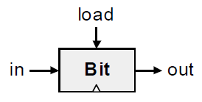
Bit (1-bit register)
Chip name: Bit
Inputs: in, load
Outputs: out
Function: If load(t-1) then out(t)=in(t-1)
else out(t)=out(t-1)
Notes:
DFF(in=outMux, out=out, out=x)
Mux(a=x, b=in, sel=load, out=outMux)

Slide 6
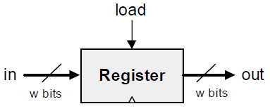
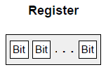
Register
Chip name: Register
Inputs: in[16], load
Outputs: out[16]
Function: If load(t-1) then out(t)=in(t-1)
else out(t)=out(t-1)
Comment: “=” is a 16-bit operation.

Slide 7
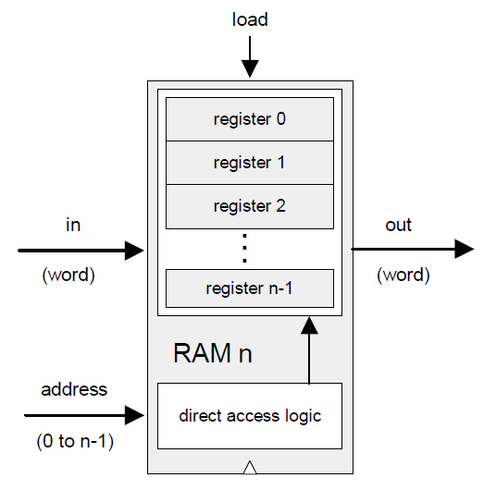
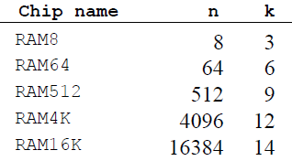
RAMn
Chip name: RAMn // n and k are listed below
Inputs: in[16], address[k], load
Outputs: out[16]
Function: out(t)=RAM[address(t)](t)
If load(t-1) then RAM[address(t-1)](t)=in(t-1)
Comment: “=” is a 16-bit operation.
Notes:
Mux = קריאה, Dmux = כתיבה
RAM = נתונים (Data) בגודל 2^14 = K16
Load = 1 => כתיבה

Slide 8
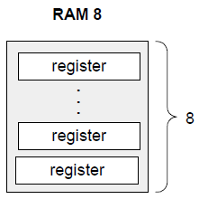
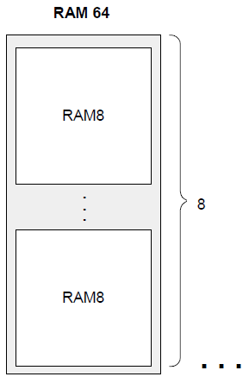
RAM8 RAM64 RAM256

Slide 9
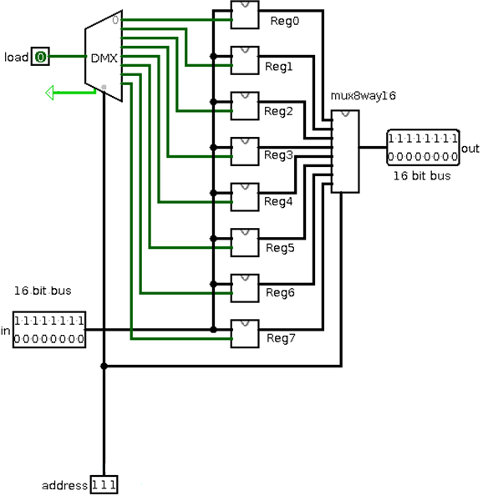
RAM8

Slide 10
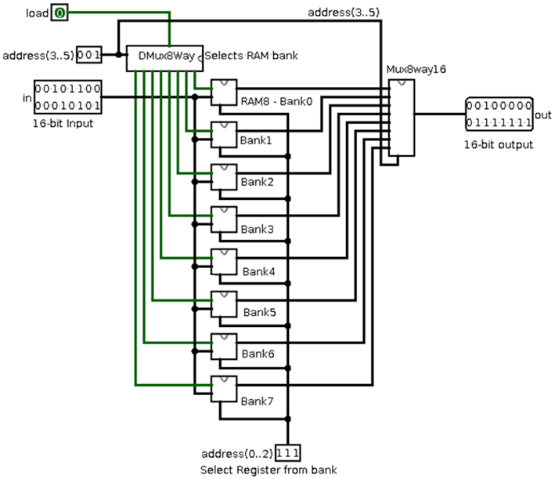
RAM64

Slide 11
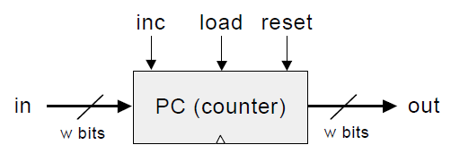
PC
Chip name: PC // 16-bit counter
Inputs: in[16], inc, load, reset
Outputs: out[16]
Function: If reset(t-1) then out(t)=0
else if load(t-1) then out(t)=in(t-1)
else if inc(t-1) then out(t)=out(t-1)+1
else out(t)=out(t-1)
Comment: “=” is 16-bit assignment.
“+” is 16-bit arithmetic addition.
Notes:
ROM = פקודות

Slide 12
Twist
The ALU chip has 6 control inputs, which means 2^6 = 64 different combinations. In the book there only 18 documented combinations; we would like to reveal what some of the hidden combinations do.
We will represent the six controls (zx, nx, zy, ny, f, no) as an array: zx- the first bit, nx - the second bit, etc.
Please add to the end of the README file:
In the last-2 line: write -2 control array.
In the last-1 line: write x and y control array.
In the last line: write x nor y control array.
Notes:
חשוב לוודא שהן אכן השורות האחרונות בקובץ הREADME (שאין שורות רווח ריקות)

Slide 13
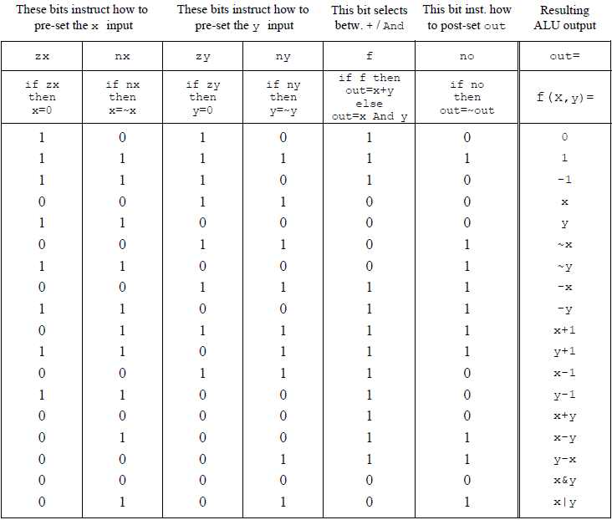
Notes:
הגדרה של פונקציה בוליאנית- קלט ופלט בביטים
$=2^{2^{n}}$ מספר פונקציות אפשריות כאשר n הוא מספר המשתנים
סה"כ יש 64 פונקציות אפשריות (לא חח"ע!)
למשל את D! אפשר ליצג בכמה דרכים: 001101 011100

Slide 14
How and what to submit
Create a folder named 2015B_exXX_YYYYYYYY, when XX is the ex number, and YYYYYYYY is your ID.
For example: 2015B_ex10_123456789
All submission files should be in that folder, and no other extra file. Files to submit: HDL files, README.txt
Zip the folder to a zip file named 2015B_exXX_YYYYYYYY.zip

